Slide 1

UE20CS390B – Capstone Project Phase – 2
Project Progress Review # 1
Project Title : Deploy eox microservices using cloud platform service and improve scalability.
Project ID : PW_23_VP_01
Project Guide : Prof Venkatesh Prasad, Mr.Vijay R(EOX Vantage)
Project Team : Veena Garag PES1UG20CS492
Adarsh Kumar PES2UG20CS016
Suchit S Kallapur PES1UG20CS438
Yuvaraj D C PES1UG20CS521

Slide 2
Deploy eox microservices using cloud platform service and improve scalability.
Abstract and Scope
Our project mainly deals with deploying microservices on cloud.
There are various challenges like security, performance, scalability, cost management, interoperability and flexibility, high dependence on network, and multi cloud environment
Here we are concerned with performance and scalability while deploying microservices using hybrid cloud platforms.
This is a complex and difficult process when cross-platform comes into play.

Slide 3
Deploy eox microservices using cloud platform service and improve scalability.
Summary of Work Done in Capstone Project Phase - 1
Conducted a comprehensive literature survey to gather relevant information.
Concluded that a custom scaling algorithm would be beneficial for the project.
Proposed the integration of Istio service mesh into the project's architecture.
Identified and recommended the adoption of essential tools including Prometheus, Grafana, Kiali, and Locust.
Overall, Phase 1 involved extensive research, strategic planning, and practical application to enhance the project's infrastructure and capabilities.

Slide 4
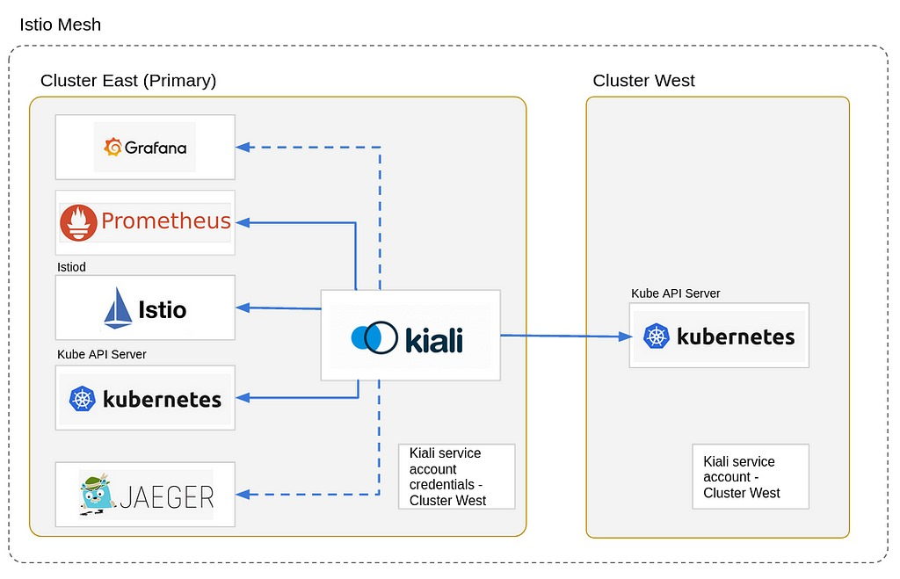
Deploy eox microservices using cloud platform service and improve scalability.
Architecture

Slide 5
Deploy eox microservices using cloud platform service and improve scalability.
List of Tasks/Modules
Monitoring Module:
Tool: Prometheus
Purpose: Continuous monitoring of microservices and system metrics.
Activities: Collecting, storing, and querying metrics to gain insights into system performance.
Visualization Module:
Tool: Grafana
Purpose: Creating visual dashboards for real-time data visualization.
Activities: Designing and configuring dashboards to display key performance indicators and metrics.
Alerting Module:
Tool: Prometheus (Alert Manager component)
Purpose: Setting up alerts for abnormal system behavior.
Activities: Defining alert rules and thresholds to notify administrators of potential issues.
Scaling Module:

Slide 6
Deploy eox microservices using cloud platform service and improve scalability.
List of Tasks/Modules
Integration Module:
Tool: Istio
Purpose: Integrating Istio service mesh for traffic management and security.
Activities: Configuring Istio to manage microservices' communication, secure traffic, and enable advanced routing.
Diagnostic Module:
Tool: Kiali
Purpose: Visualizing and troubleshooting microservice interactions within the service mesh.
Activities: Analyzing service dependencies, identifying bottlenecks, and diagnosing issues in the application's communication.

Slide 7
Deploy eox microservices using cloud platform service and improve scalability.
Individual Contribution
Candidate name | Task performed
Yuvaraj D C | grafana & kiali
Suchit S Kallapur | locust & grafana
Adarsh Kumar | kiali & prometheus
Veena Garag | prometheus & locust

Slide 8
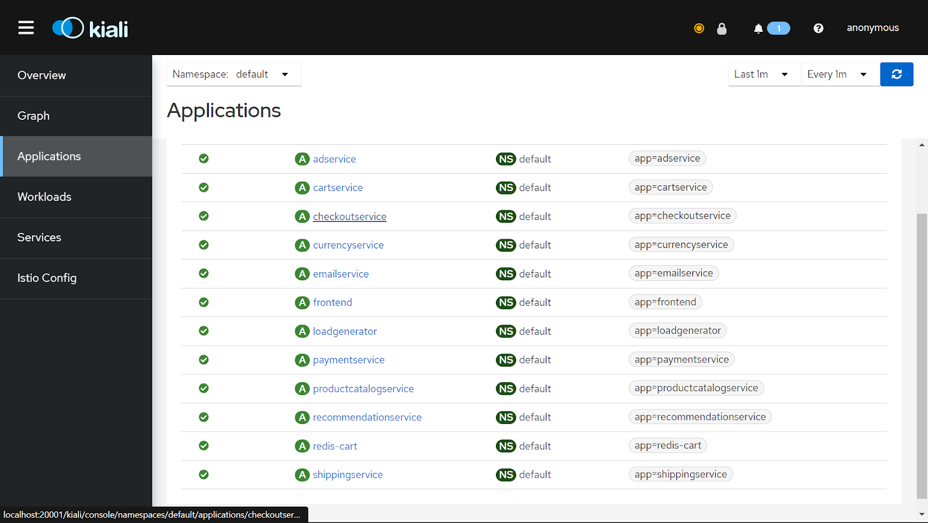
Deploy eox microservices using cloud platform service and improve scalability.
Demonstration and Testing of the Modules Completed

Slide 9
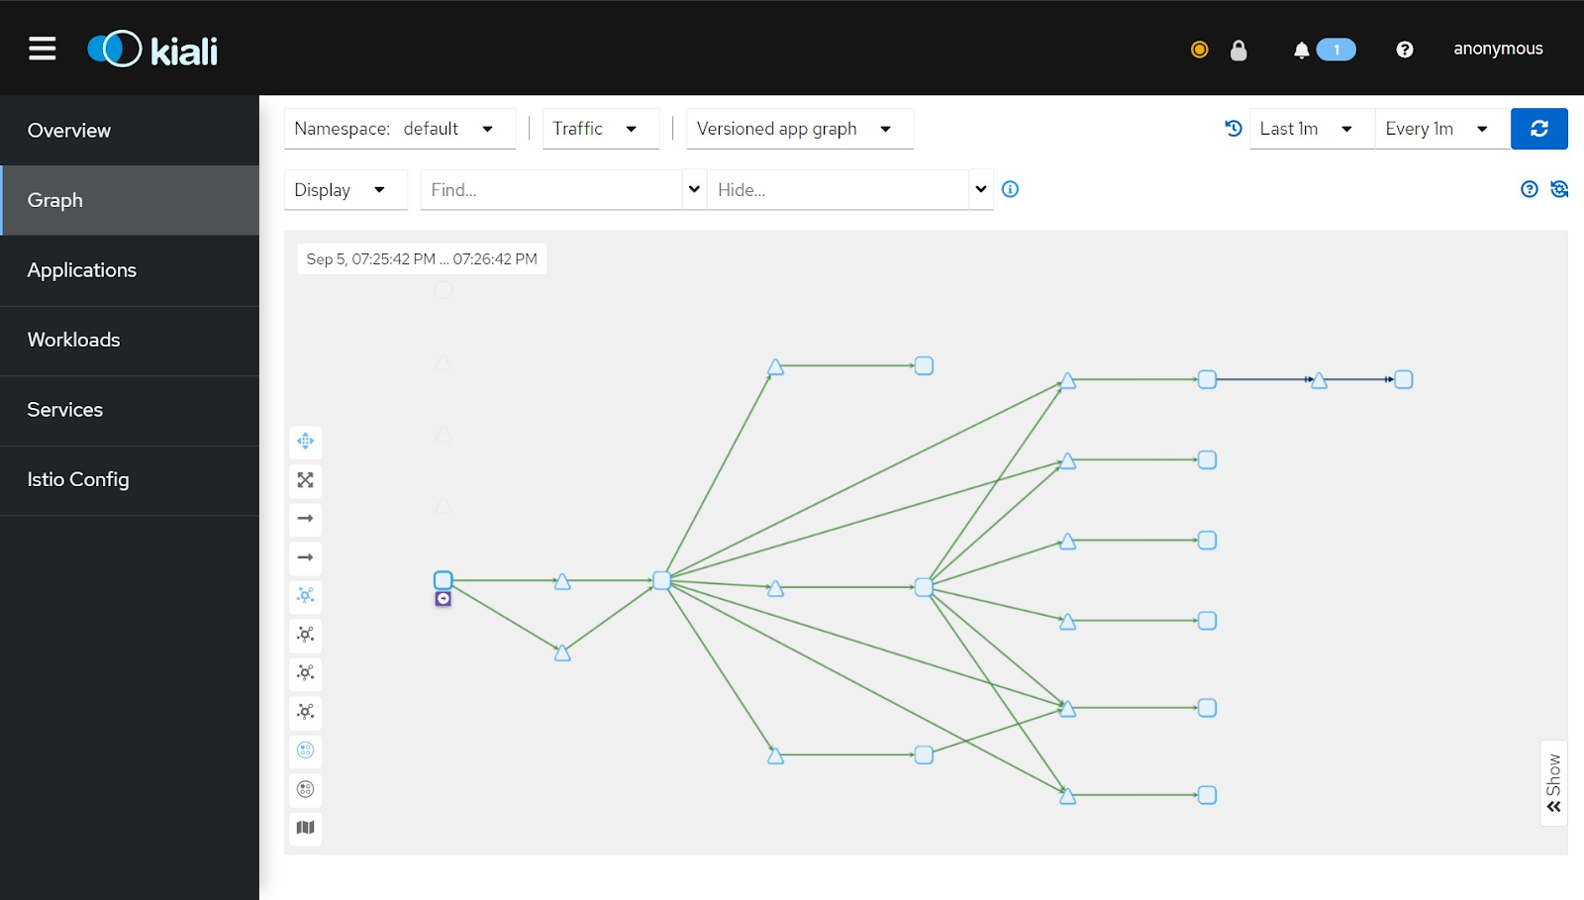
Deploy eox microservices using cloud platform service and improve scalability.
Demonstration and Testing of the Modules Completed

Slide 10
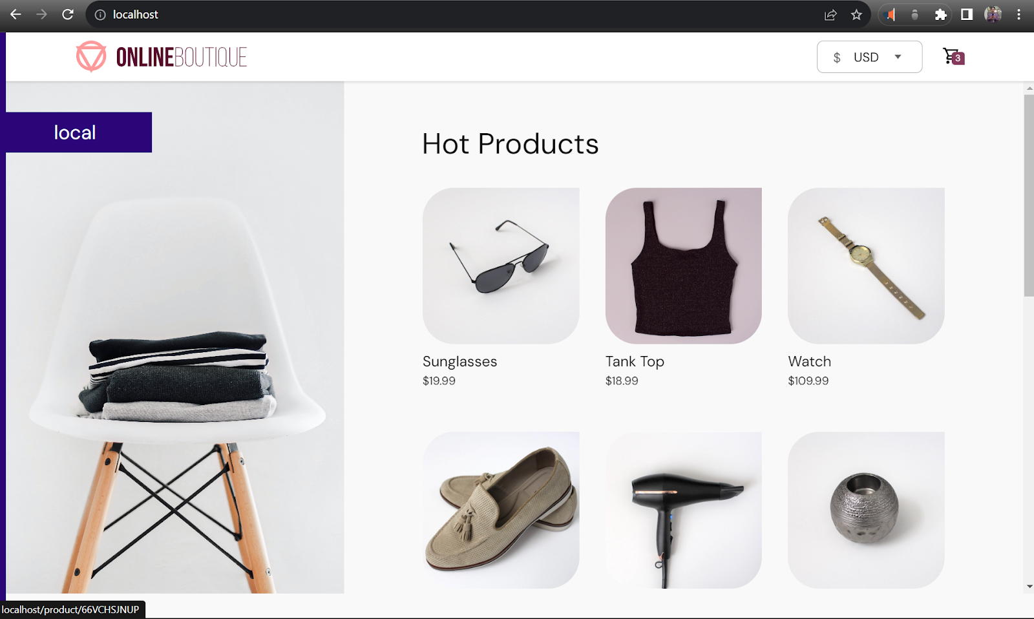
Deploy eox microservices using cloud platform service and improve scalability.
Demonstration and Testing of the Modules Completed

Slide 11
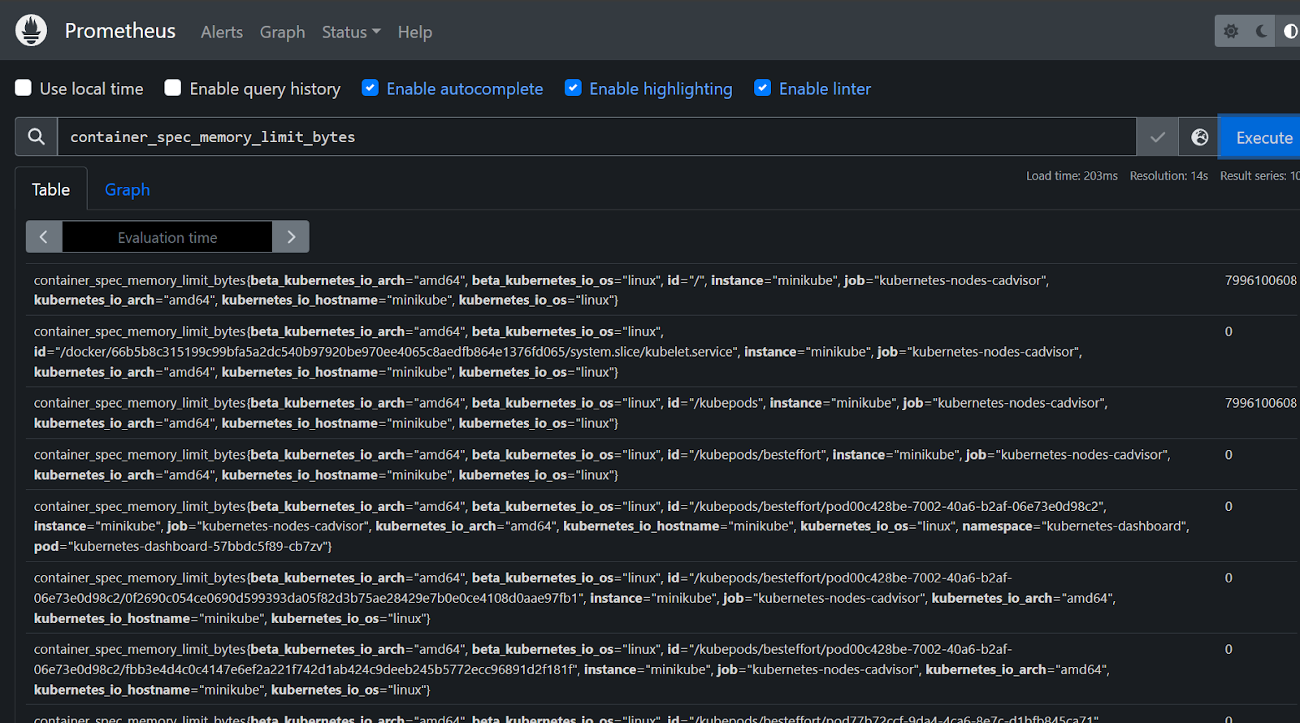
Deploy eox microservices using cloud platform service and improve scalability.
Demonstration and Testing of the Modules Completed

Slide 12
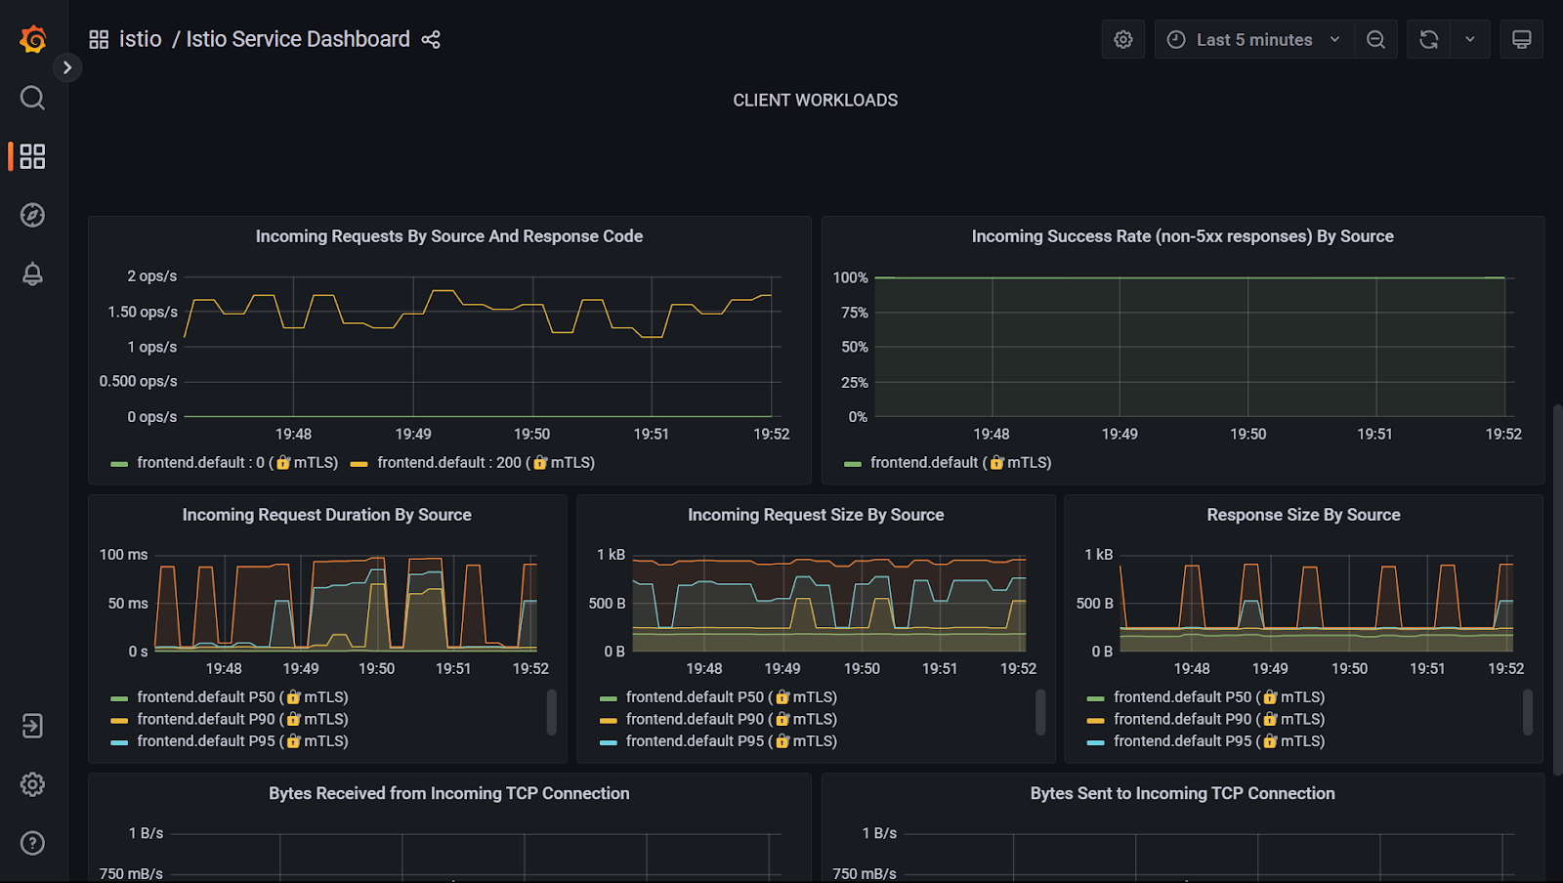
Deploy eox microservices using cloud platform service and improve scalability.
Demonstration and Testing of the Modules Completed

Slide 13
Deploy eox microservices using cloud platform service and improve scalability.
References
Deshpande, Neha (2021) Autoscaling Cloud-Native Applications using Custom Controller of Kubernetes.
https://norma.ncirl.ie/5089/
Masters thesis, Dublin, National College of Ireland.
Shitole, Abhishek Sanjay (2022) Dynamic Load Balancing of Microservices in Kubernetes Clusters using Service Mesh.
https://norma.ncirl.ie/5943/
Masters thesis, Dublin, National College of Ireland.
An Efficient and Scalable Traffic Load Balancing Based on Web Server Container Resource Utilization using Kubernetes Cluster.(May – 2022) Ashok L Pomnar,
AVCOE Sangamner 422 605,Maharashtra, India.
https://ijisrt.com/assets/upload/files/IJISRT22MAY1644_(1)_(1).pdf
V. Sharma, "Managing Multi-Cloud Deployments on Kubernetes with Istio, Prometheus and Grafana," 2022 8th International Conference on Advanced Computing and Communication Systems (ICACCS), Coimbatore, India,
https://doi.org/10.1109/ICACCS54159.2022.9785124

Slide 14
Thank You

